Slide 1
SAT and ACT analysis

Slide 2
Problem Statement
The “SAT or ACT?” problem has always plagued the minds of would-be college students. Coupled with the problem of poverty in the United States, there are serious issues of high achieving students not being able to proceed to college due to them coming from lower-income families.
Hence, this project seeks to understand trends in the SAT and ACT tests for the years 2017 to 2019 and if household income level has an impact on participation rate and performance of these tests.

Slide 3
Datasets used:
2017 ACT test data
2018 ACT test data
2019 ACT test data
2017 SAT test data
2018 SAT test data
2019 SAT test data
Additional Datasets used:
Median income level across states in the US (2019)
Median income level across states in the US (2017 – 2018)

Slide 4
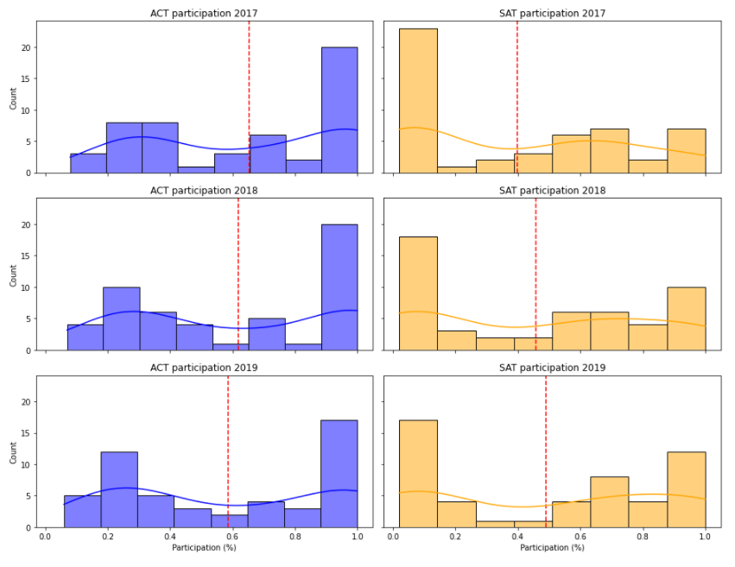
Trend of test takers moving from ACT to SAT
Mean participation increasing for SAT and decreasing for ACT.

Slide 5
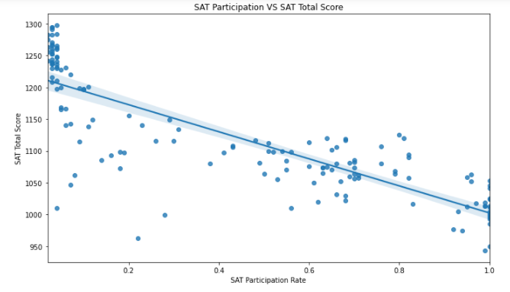
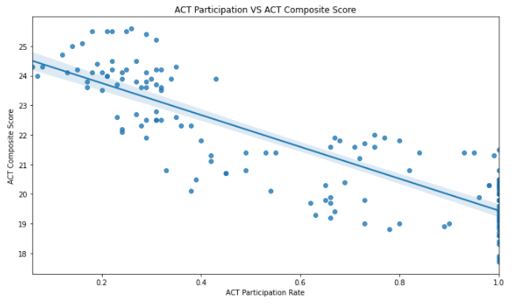
Inverse relationship between participation rate and test scores
SAT and ACT test scores have a moderately negative relationship with participation rates. Students do better when they are not mandated to take the tests.

Slide 6
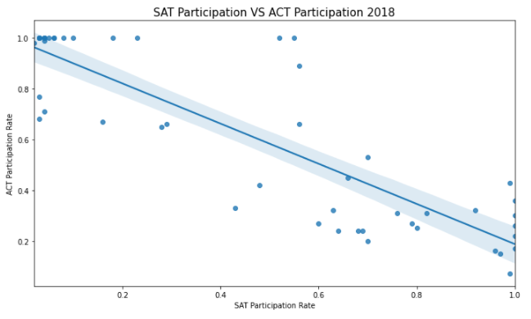

Inverse relationship between participation rate of ACT and SAT tests
SAT and ACT participation rates are negatively correlated with each other. It is unlikely that a student mandated to take ACT will further take up SAT, and vice versa.

Slide 7
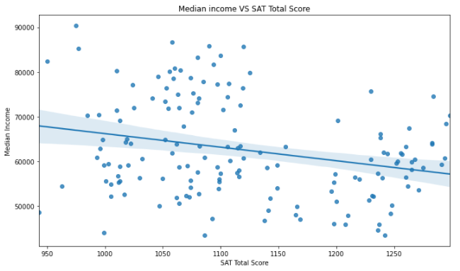
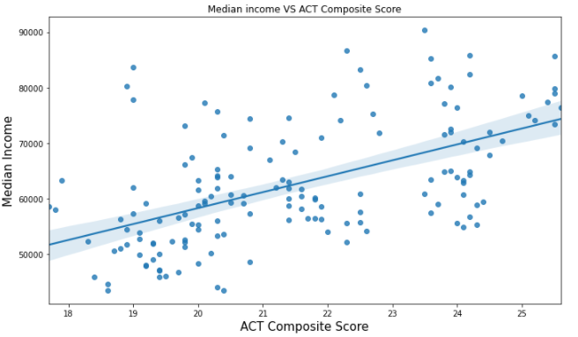
Relationship between median income and scores of ACT and SAT tests
As median income increases, score for ACT test increases. The reverse is true for the SAT test. This suggests that households are more willing to spend on the ACT tests and ACT is viewed more favourably than the SAT.

Slide 8
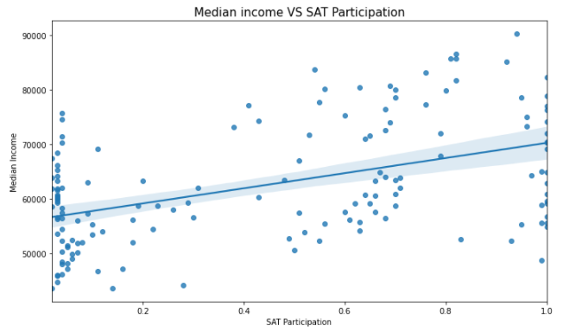
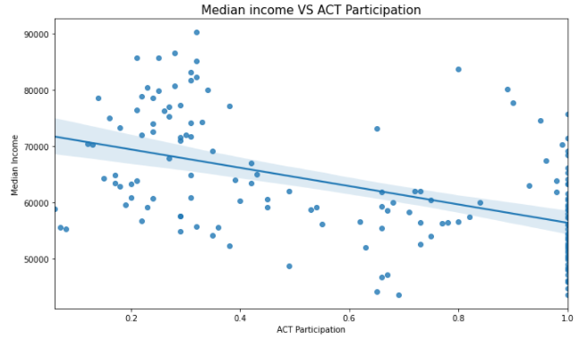
Relationship between median income and participation rate of ACT and SAT tests
Noted moderate positive correlation SAT participation and median income. Reverse if true for SAT participation. Cluster noted at upper left of ACT participation plot where households with higher income participate in ACT.

Slide 9
Recommendations
Offering bursaries / grants to high achieving students from low-income families, especially states with mandatory ACT requirements.
Offering test free waivers to lower entry barrier of students from low-income families
Increase student and family awareness of college accessibility, train school staff to encourage and inculcate “college going” culture
Mandating completion of ACT / SAT for high school students
Advocate for and support schools which strive to achieve equity of outcomes
Advocate for and support intervention programs that provide academic, social and community support to raise the success of disadvantaged children and youth

